Slide 2

Power BI Incremental refresh made simple
Notes:
Photo by <a href="https://unsplash.com/es/@jakobustrop?utm_source=unsplash&utm_medium=referral&utm_content=creditCopyText">Jakob Braun</a> on <a href="https://unsplash.com/photos/XK-aFVsgksE?utm_source=unsplash&utm_medium=referral&utm_content=creditCopyText">Unsplash</a>

Slide 3

Notes:
Photo by Brett Jordan on Unsplash

Slide 4

Notes:
All the code, presentation and links are included in the GitHub Repo
Photo by <a href="https://unsplash.com/@kellysikkema?utm_source=unsplash&utm_medium=referral&utm_content=creditCopyText">Kelly Sikkema</a> on <a href="https://unsplash.com/photos/Z9AU36chmQI?utm_source=unsplash&utm_medium=referral&utm_content=creditCopyText">Unsplash</a>

Slide 5
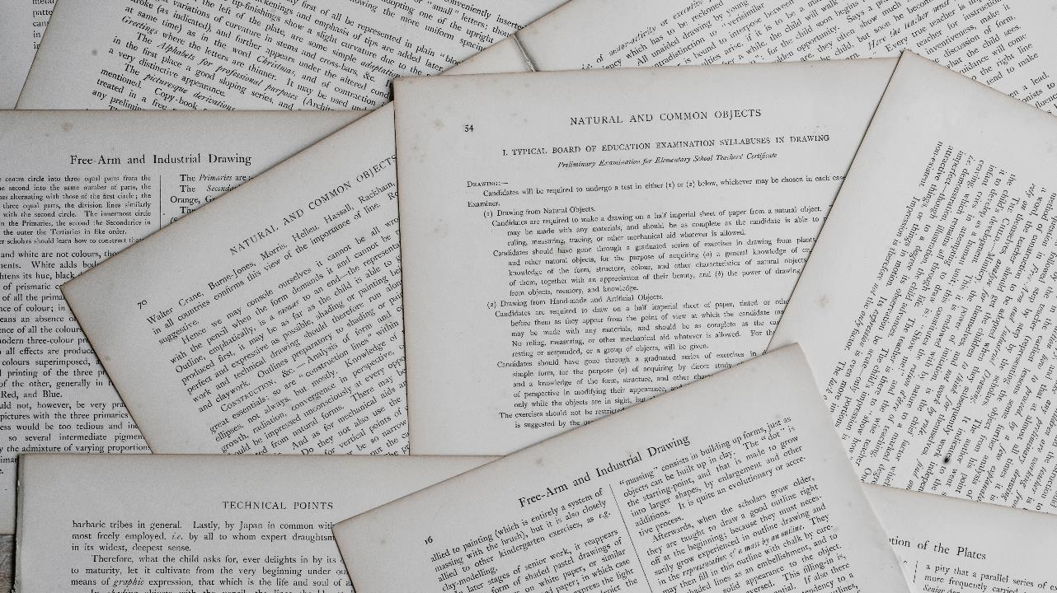
Notes:
There is documentation from Microsoft on increment refresh
Photo by <a href="https://unsplash.com/@anniespratt?utm_source=unsplash&utm_medium=referral&utm_content=creditCopyText">Annie Spratt</a> on <a href="https://unsplash.com/photos/5cFwQ-WMcJU?utm_source=unsplash&utm_medium=referral&utm_content=creditCopyText">Unsplash</a>

Slide 6

Notes:
After reading the documentation I felt a little “discombobualated”
Photo by <a href="https://unsplash.com/@brett_jordan?utm_source=unsplash&utm_medium=referral&utm_content=creditCopyText">Brett Jordan</a> on <a href="https://unsplash.com/photos/-JbOrVnwYjw?utm_source=unsplash&utm_medium=referral&utm_content=creditCopyText">Unsplash</a>

Slide 7

Notes:
And more than a little confused and alarmed
Photo by <a href="https://unsplash.com/@mtresemer?utm_source=unsplash&utm_medium=referral&utm_content=creditCopyText">Michelle Tresemer</a> on <a href="https://unsplash.com/photos/MjKUUaYQQ6U?utm_source=unsplash&utm_medium=referral&utm_content=creditCopyText">Unsplash</a>

Slide 8

Notes:
So if you feel confused well you are in good company as I was also very confused !!!
Photo by <a href="https://unsplash.com/es/@brucemars?utm_source=unsplash&utm_medium=referral&utm_content=creditCopyText">bruce mars</a> on <a href="https://unsplash.com/photos/xj8qrWvuOEs?utm_source=unsplash&utm_medium=referral&utm_content=creditCopyText">Unsplash</a>

Slide 9

Notes:
So I did some experimenting to see if I could understand how it worked as I did not understand so much !
Photo by <a href="https://unsplash.com/@nicolasthomas?utm_source=unsplash&utm_medium=referral&utm_content=creditCopyText">Nicolas Thomas</a> on <a href="https://unsplash.com/photos/3GZi6OpSDcY?utm_source=unsplash&utm_medium=referral&utm_content=creditCopyText">Unsplash</a>

Slide 10
Minimum requirements
Power BI pro licence
Or
Power BI Premium Per User licence
Or
Premium per capacity

Slide 11
Assumed knowledge
How to do the following -:
Connect Data Flow to SQL server database
Connect Data Set to SQL server database
Connect Power BI Desktop to a Data Set

Slide 12

bit.ly/3iqCb6P
Notes:
All the code files and links are in the repo.

Slide 13

Notes:
Photo by Marcel Eberle on Unsplash

Slide 14

This Photo by Unknown Author is licensed under CC BY-SA
Notes:
Why should you use incremental refresh

Slide 15

Notes:
Photo by Priscilla Du Preez on Unsplash

Slide 16

Rolling Window
Notes:
Photo by <a href="https://unsplash.com/@loic?utm_source=unsplash&utm_medium=referral&utm_content=creditCopyText">Djim Loic</a> on <a href="https://unsplash.com/wallpapers/desktop/windows?utm_source=unsplash&utm_medium=referral&utm_content=creditCopyText">Unsplash</a>

Slide 17

Notes:
Photo by Markus Spiske on Unsplash

Slide 18

Notes:
Lets say hello to the data
Photo by <a href="https://unsplash.com/@lemonvlad?utm_source=unsplash&utm_medium=referral&utm_content=creditCopyText">Vladislav Klapin</a> on <a href="https://unsplash.com/photos/PVr9Gsj93Pc?utm_source=unsplash&utm_medium=referral&utm_content=creditCopyText">Unsplash</a>

Slide 19


Slide 20

Notes:
Photo by Ivan Henao on Unsplash
Building the components

Slide 21


Slide 22

Notes:
One of the questions we have not answer is who is speaking
Photo by <a href="https://unsplash.com/@evan__bray?utm_source=unsplash&utm_medium=referral&utm_content=creditCopyText">Evan Dennis</a> on <a href="https://unsplash.com/photos/i--IN3cvEjg?utm_source=unsplash&utm_medium=referral&utm_content=creditCopyText">Unsplash</a>

Slide 23






Robert French
Data Shepherd,
Data Plumber,
Data Dance Teacher
#DressUpFriday
https://www.qnrl.com/
@SqlBobScot @techhub.social
https://www.linkedin.com/in/rwlpfrench/
@SqlBobScot
rwlp.french@gmail.com

Slide 24
Data Team

Slide 25












Data & AI
Data Architecture
and Strategy
DBA as
a Service
Data Movement
& Migration
Master Data
Management
Business
Intelligence
AI
Technologies

Slide 26

















Slide 27

Notes:
Photo by Priscilla Du Preez on Unsplash

Slide 28
Notes:
Photo by Marcel Eberle on Unsplash

Slide 29
This Photo by Unknown Author is licensed under CC BY-SA
Notes:
Why should you use incremental refresh

Slide 30
1) Lower Refresh Times
2) More Reliable Queries
3) Less Resource Consumption
Notes:
Lower Refresh Times – In order to refresh the data model from the entire database, it might take a long time. However, in the case of an incremental refresh, since we are bringing in only a small portion of the data, refreshes are generally faster
More Reliable Queries – As we refresh a Power BI data model, in the background SQL queries are being fired to the database engine. Queries that run for a shorter duration are more reliable as they do not lock the database for long periods
Less Resource Consumption – Due to the lower runtime of the queries, the database resources consumed are also quite less

Slide 31

Notes:
Before setting up incremental refresh you have to ask some questions

Slide 32

Notes:
How long do you need to keep the data for?
Photo by <a href="https://unsplash.com/@aronvisuals?utm_source=unsplash&utm_medium=referral&utm_content=creditCopyText">Aron Visuals</a> on <a href="https://unsplash.com/photos/BXOXnQ26B7o?utm_source=unsplash&utm_medium=referral&utm_content=creditCopyText">Unsplash</a>

Slide 33

Notes:
How often do you update the data?
Photo by <a href="https://unsplash.com/es/@markuswinkler?utm_source=unsplash&utm_medium=referral&utm_content=creditCopyText">Markus Winkler</a> on <a href="https://unsplash.com/photos/cxoR55-bels?utm_source=unsplash&utm_medium=referral&utm_content=creditCopyText">Unsplash</a>

Slide 34
Business requirements
“Keep two years of data”
“Refresh last two weeks of data”

Slide 35
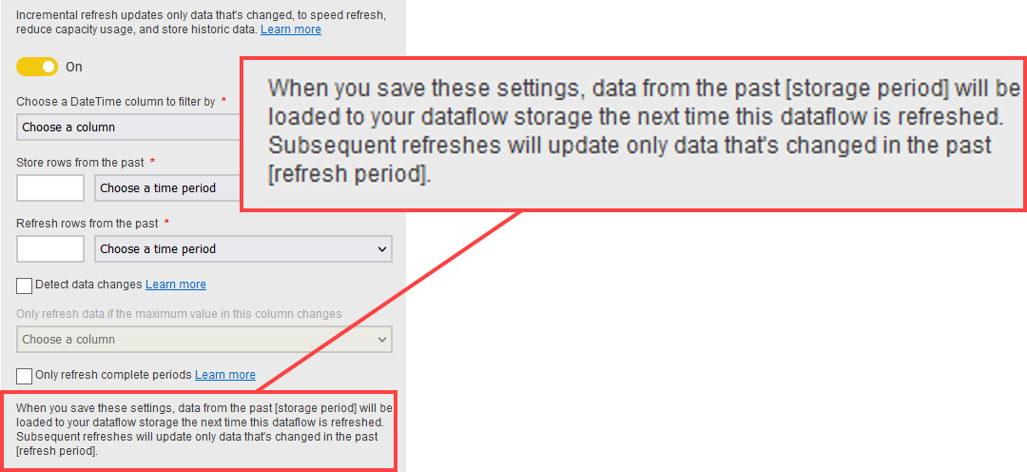

Slide 36

Notes:
After reading that many times this is how I felt
Photo by Andrea Piacquadio: https://www.pexels.com/photo/yelling-formal-man-watching-news-on-laptop-3760778/

Slide 37
Notes:
Photo by Priscilla Du Preez on Unsplash

Slide 38
Rolling Window
Notes:
Photo by <a href="https://unsplash.com/@loic?utm_source=unsplash&utm_medium=referral&utm_content=creditCopyText">Djim Loic</a> on <a href="https://unsplash.com/wallpapers/desktop/windows?utm_source=unsplash&utm_medium=referral&utm_content=creditCopyText">Unsplash</a>

Slide 39
Load data into
Data Flow / Data Set
On 1st January 2023
Apply incremental refresh

Slide 40
Data Flow / Data Set at 1st Jan 2023
First Date 1st Jan 2021
Last Date 1st Jan 2023
Two years of data loaded
Archived Data
Incrementally refreshed data
14 Days of data
18/12/2022 to 01/01/2023

Slide 41
Refresh Data Flow
/ Data Set
Once per day
Till 8th January 2023

Slide 42
Data Flow / Data Set at 8th Jan 2023
First Date 8th Jan 2021
Last Date 8th Jan 2023
Two years of data loaded
Archived Data
Incrementally refreshed data
14 Days of data
25/12/2022 to 08/01/2023

Slide 43

Notes:
So you are now unimpressed and wondering why you came to this session
Photo by <a href="https://unsplash.com/@patrickian4?utm_source=unsplash&utm_medium=referral&utm_content=creditCopyText">Patrick Fore</a> on <a href="https://unsplash.com/photos/Qz_QW-_1CzA?utm_source=unsplash&utm_medium=referral&utm_content=creditCopyText">Unsplash</a>

Slide 44
Data Flow / Data Set at 1st Jan 2023
1st Jan 2021
1st Jan 2023
Archived Data
Incrementally refreshed data
Data Flow / Data Set at 8th Jan 2023
8th Jan 2021
8th Jan 2023
Archived Data
Incrementally refreshed data

Slide 45
Data Flow / Data Set at 1st Jan 2023
1st Jan 2021
1st Jan 2023
Archived Data
Incrementally refreshed data
This data will be deleted.
Data Flow / Data Set at 8th Jan 2023
8th Jan 2021
8th Jan 2023
Archived Data
Incrementally refreshed data
1st Jan 2021

Slide 46
Notes:
Photo by Markus Spiske on Unsplash

Slide 47
Notes:
So I did some experimenting to see if I could understand how it worked as I did not understand so much !
Photo by <a href="https://unsplash.com/@nicolasthomas?utm_source=unsplash&utm_medium=referral&utm_content=creditCopyText">Nicolas Thomas</a> on <a href="https://unsplash.com/photos/3GZi6OpSDcY?utm_source=unsplash&utm_medium=referral&utm_content=creditCopyText">Unsplash</a>

Slide 48
Notes:
Lets say hello to the data
Photo by <a href="https://unsplash.com/@lemonvlad?utm_source=unsplash&utm_medium=referral&utm_content=creditCopyText">Vladislav Klapin</a> on <a href="https://unsplash.com/photos/PVr9Gsj93Pc?utm_source=unsplash&utm_medium=referral&utm_content=creditCopyText">Unsplash</a>

Slide 49

Notes:
Photo by Antoni Shkraba: https://www.pexels.com/photo/fine-looking-man-in-black-suit-jacket-using-laptop-5467588/

Slide 50
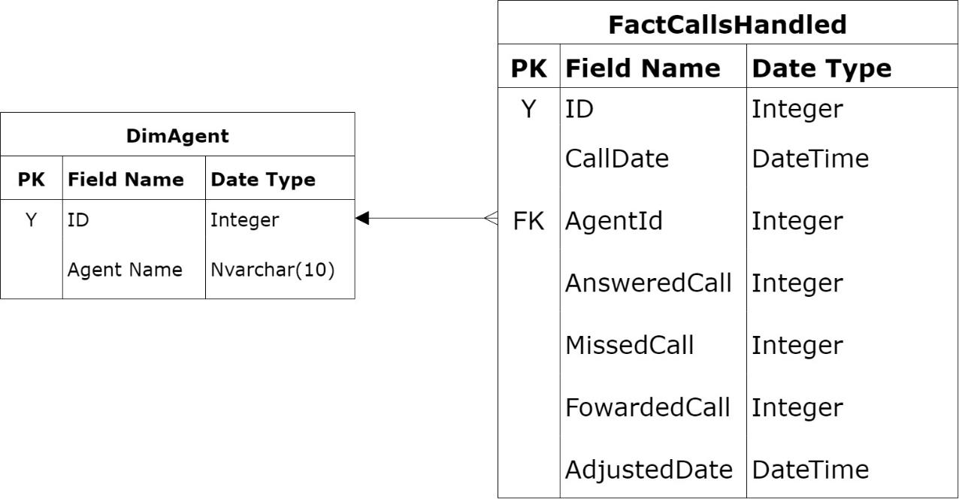

Slide 51
Notes:
The call date is the field used as part of the incremental refresh

Slide 52
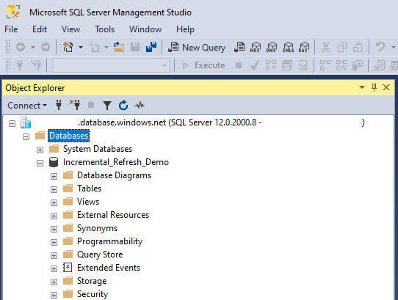
Created an empty Azure SQL Database

Slide 53
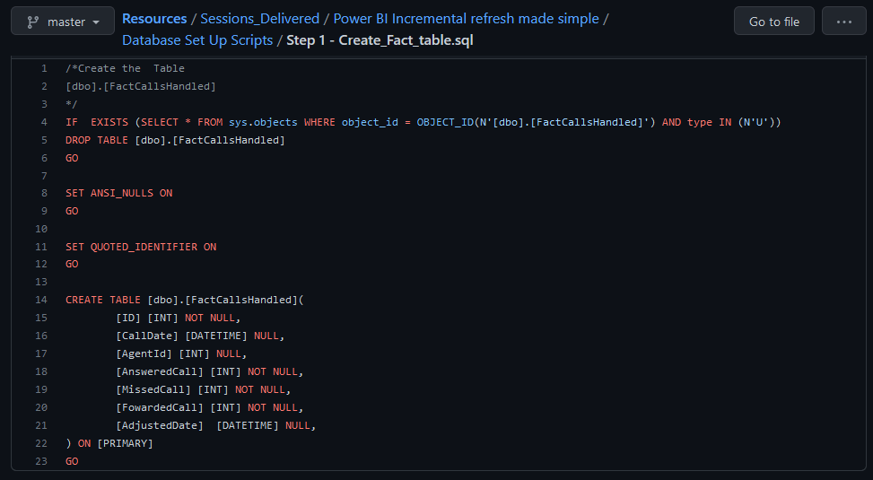
Run Script
Step 1 - CreateFactTable.sql
Notes:
This will check to see if the table exists. If it does then it will drop the table
Then it will create the table

Slide 54
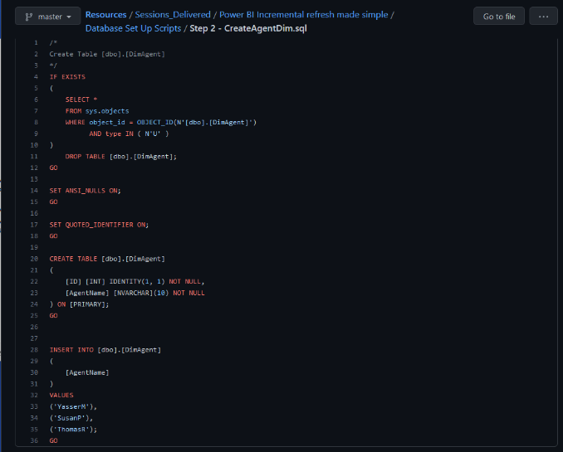
Run Script
Step 2 - CreateAgentDim.sql
Notes:
This will check to see if the table exists. If it does then it will drop the table
Then creates the table and populates it with three records

Slide 55
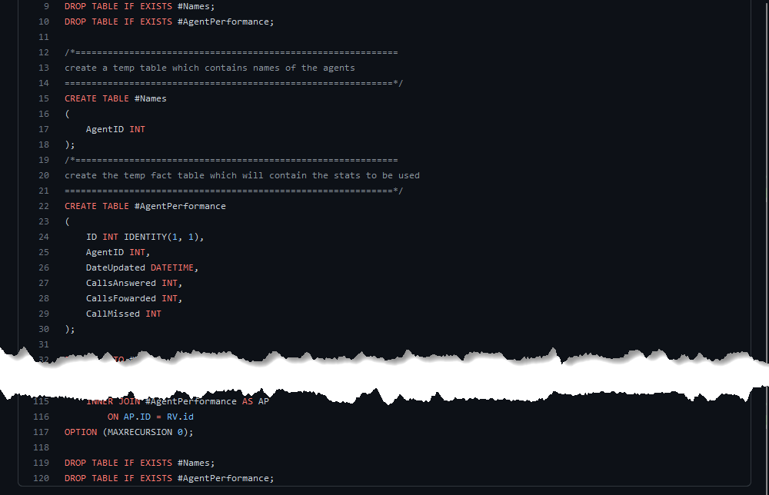
Run Script
Step 3 - GenerateFactTable.sql
Notes:
This will check to see if the table exists. If it does then it will drop the table
Then creates the table and populates it with three records

Slide 56
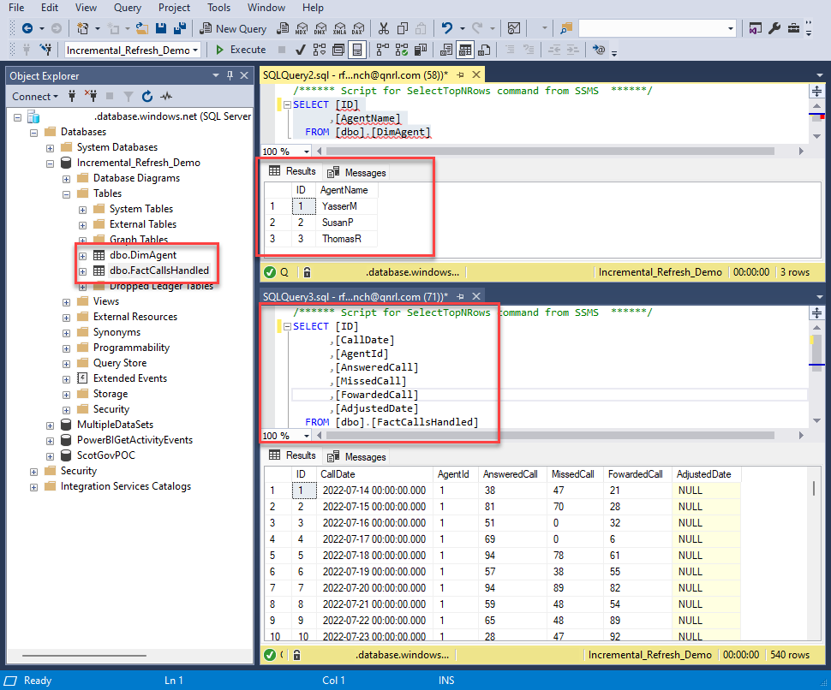

Slide 57




Premium version
Azure SQL DB
IncrementalRefresh [DF]
IncrementalRefresh [DS]
IncrementalRefresh

Slide 58
Pro version
Power BI Service
Azure SQL DB
IncrementalRefresh [DS]
IncrementalRefresh

Slide 59
See video
SetUp_DF_DS_Report.mp4
for details on to create the
Objects in previous slide
Notes:
The process described only sets up the components, in the next step we will set up incremental refresh.

Slide 61
Notes:
Photo by Ivan Henao on Unsplash
Building the components

Slide 62
Set up incremental refresh for Data Flow

Slide 63
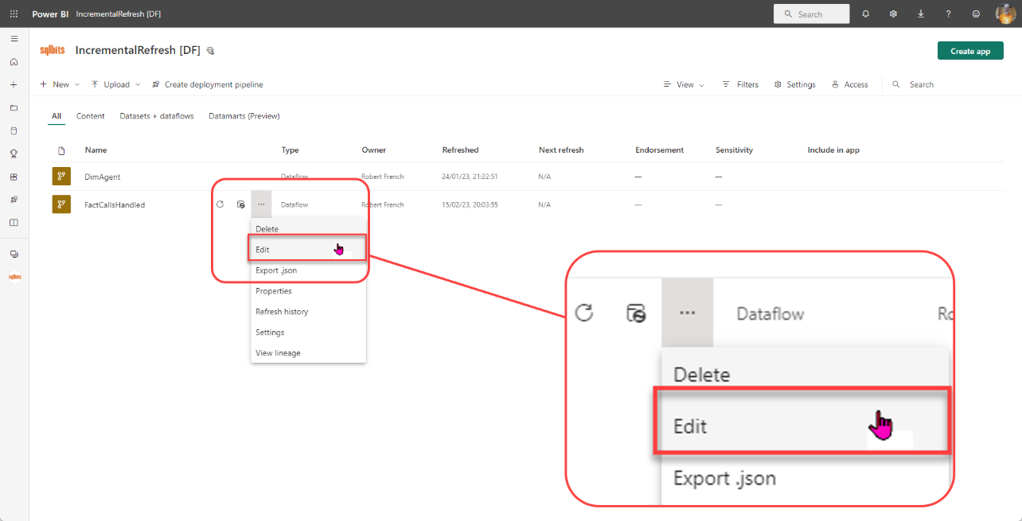

Slide 64
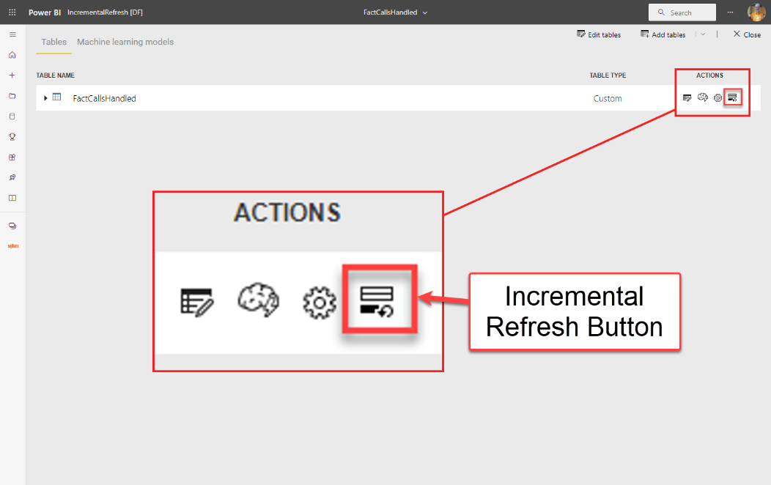

Slide 65
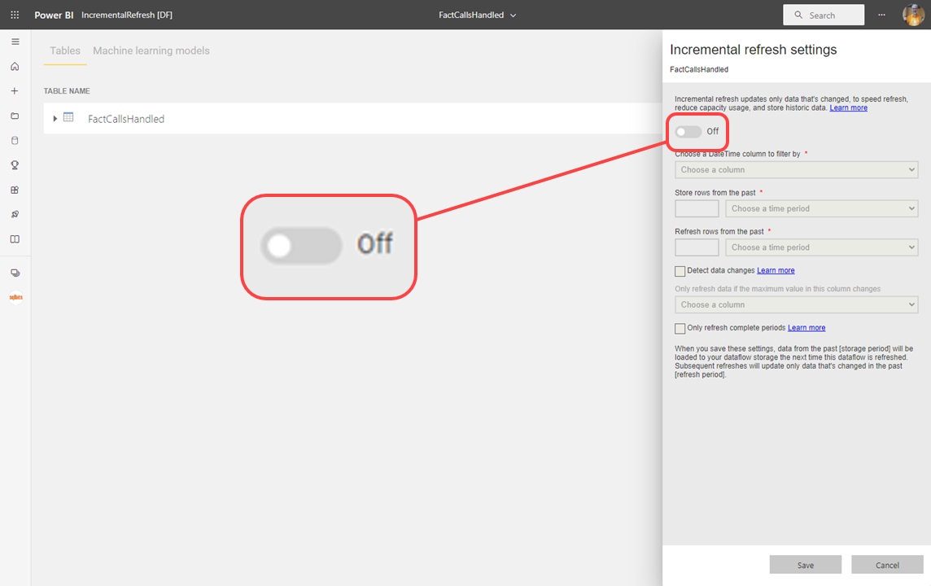

Slide 66
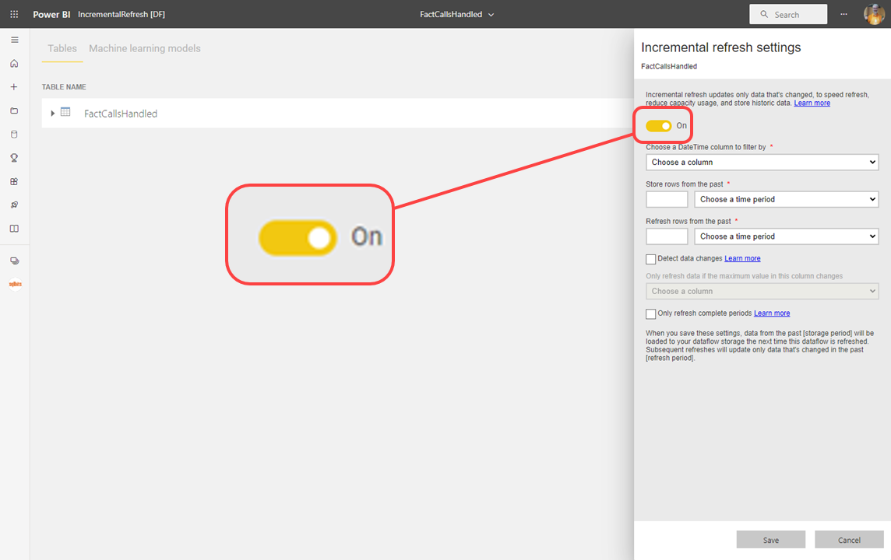

Slide 67
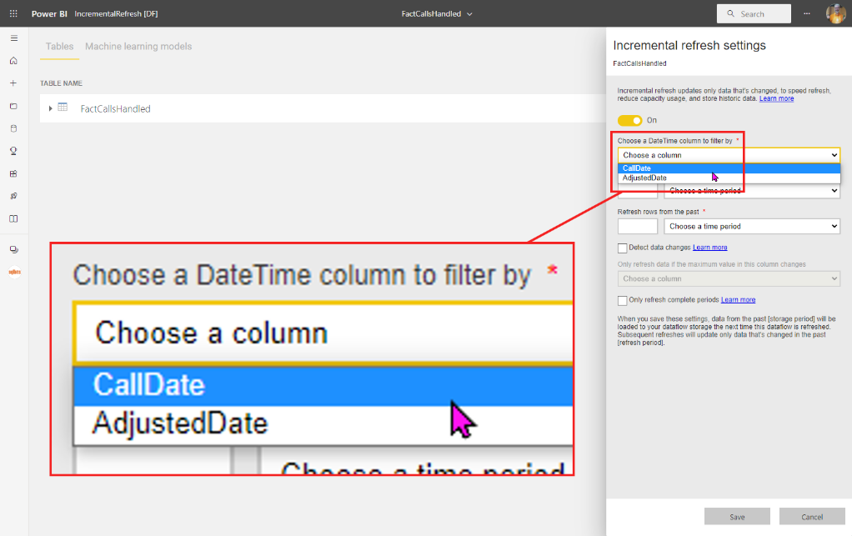

Slide 68
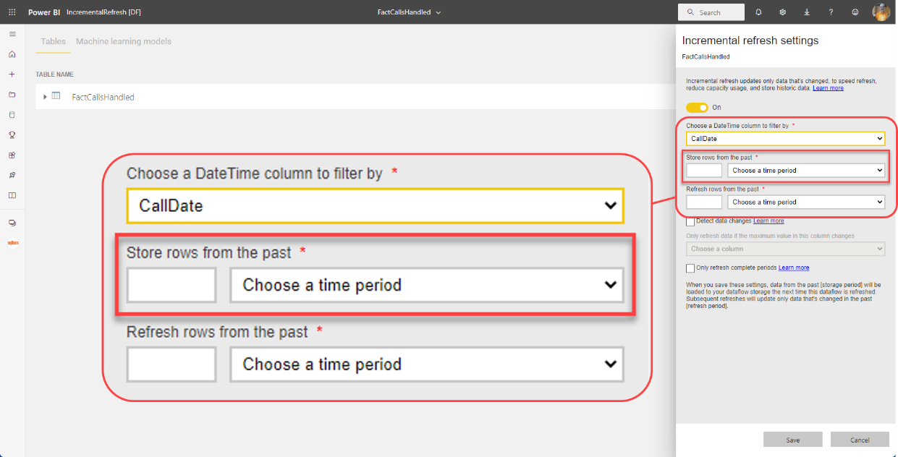

Slide 69
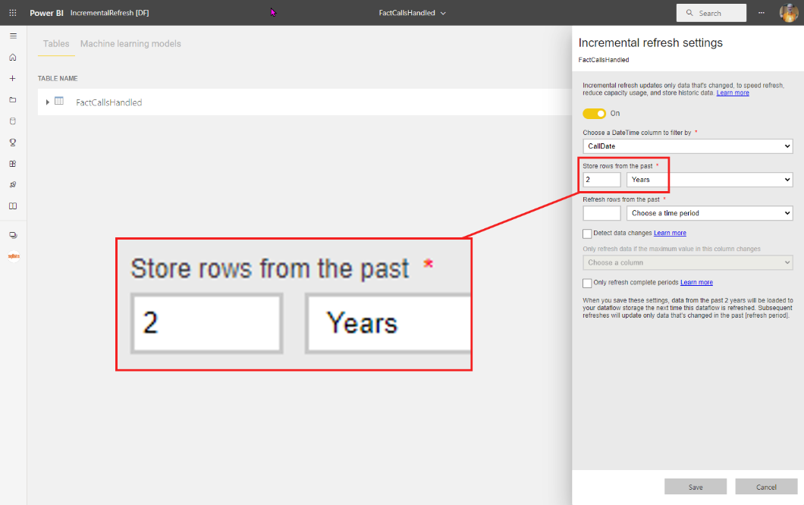

Slide 70
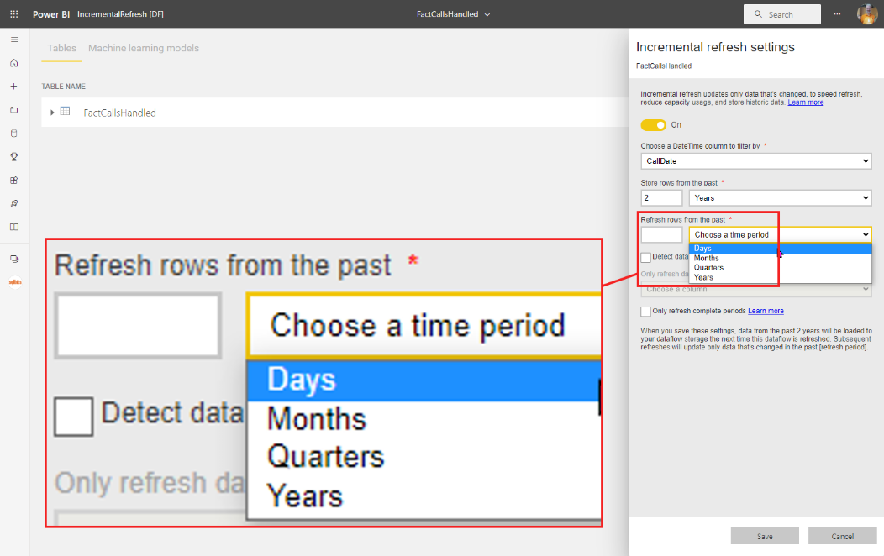

Slide 71
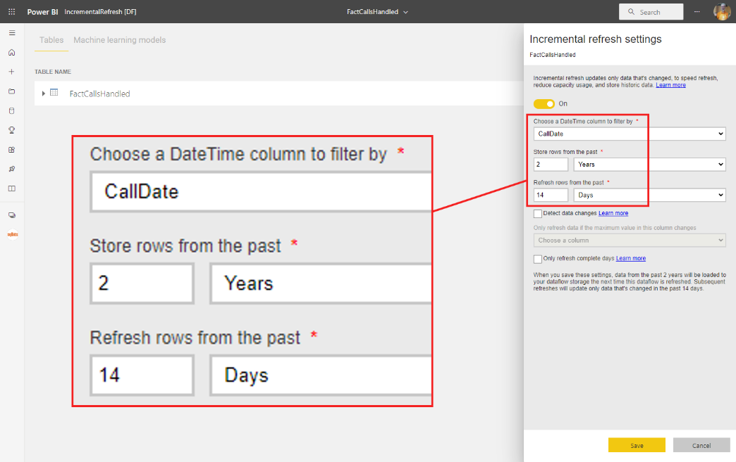

Slide 72
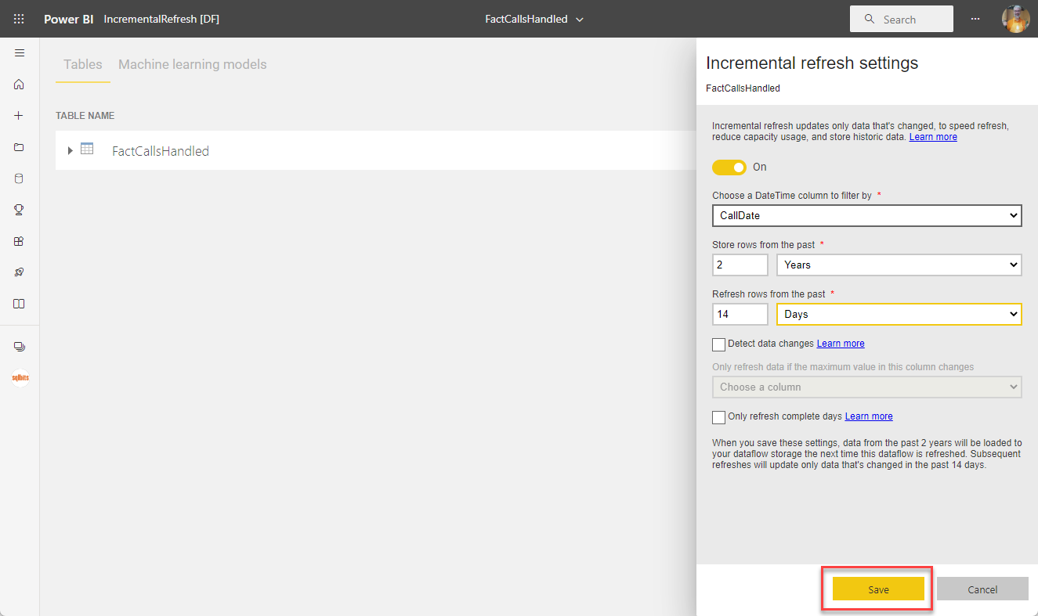

Slide 73
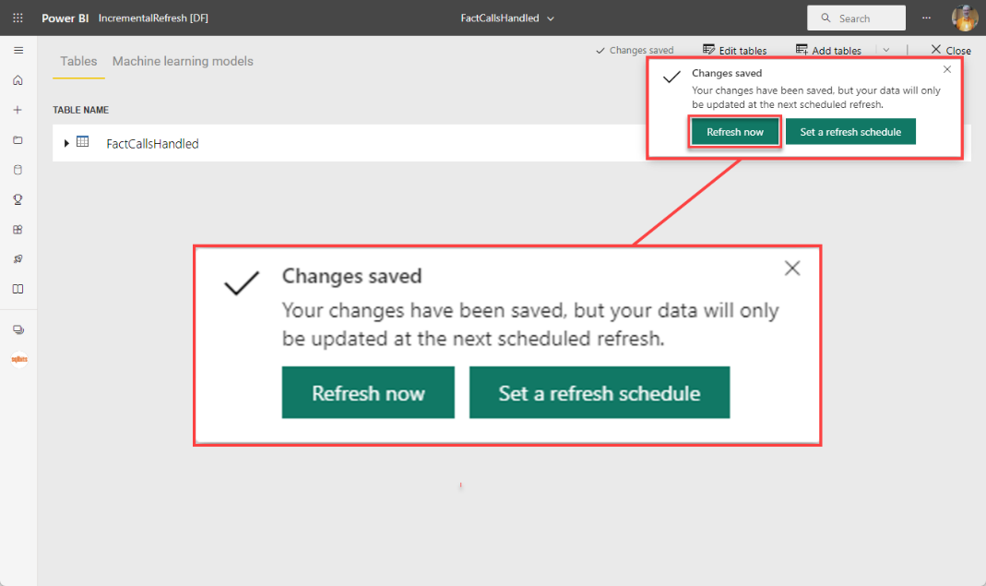

Slide 74
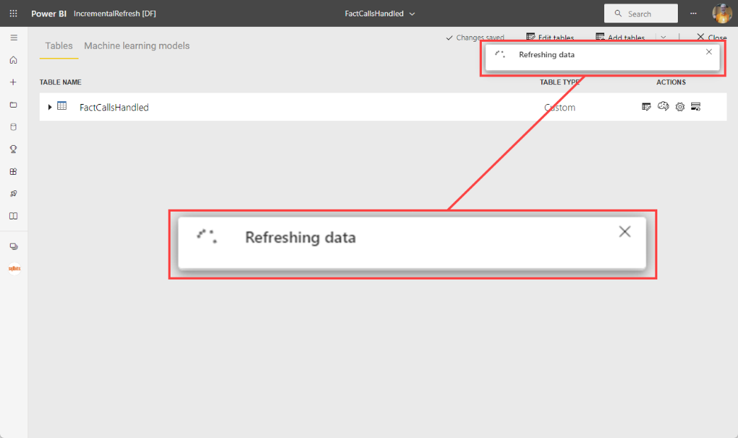

Slide 75
Set up incremental refresh for dataset

Slide 76
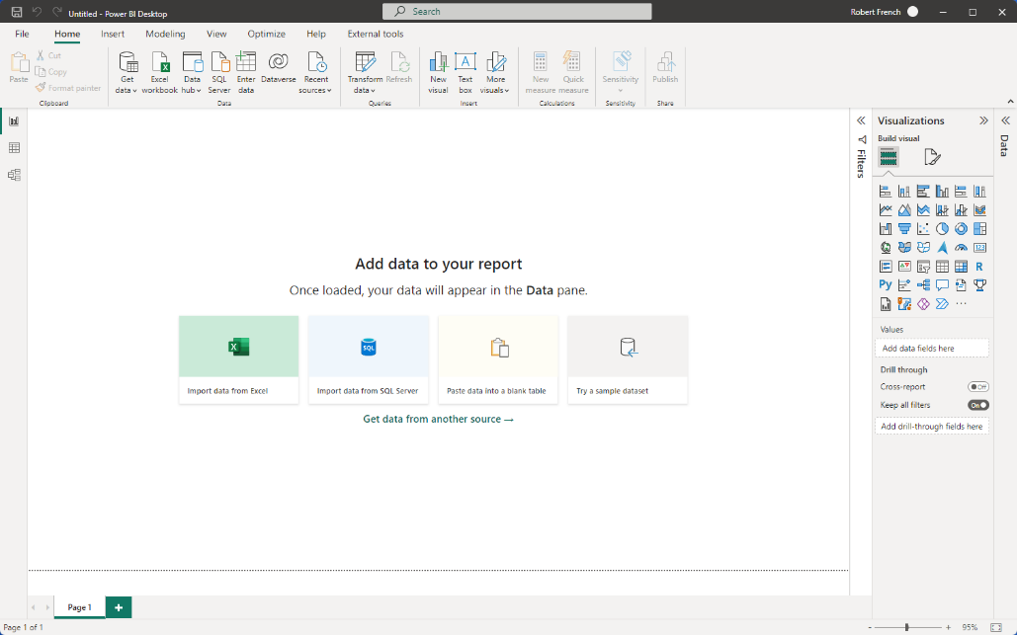

Slide 77
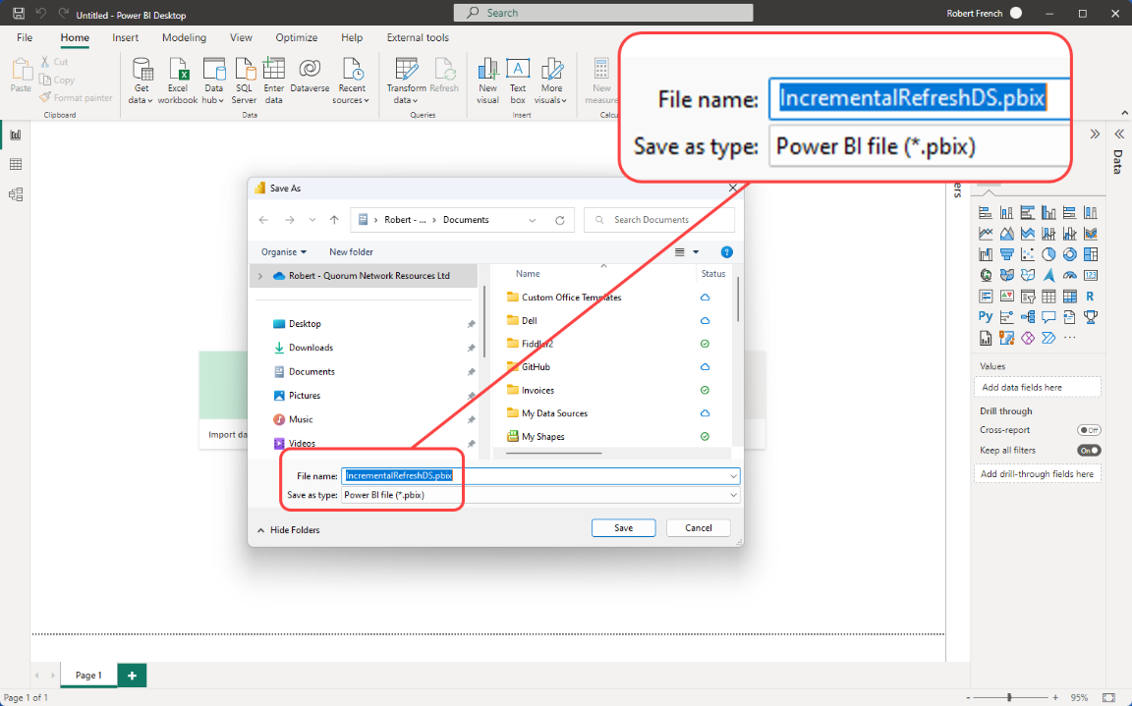

Slide 78
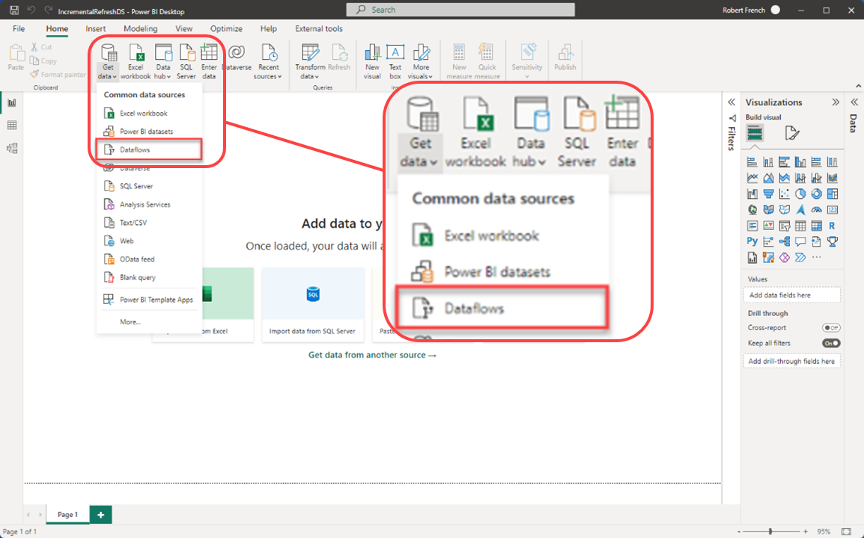

Slide 79
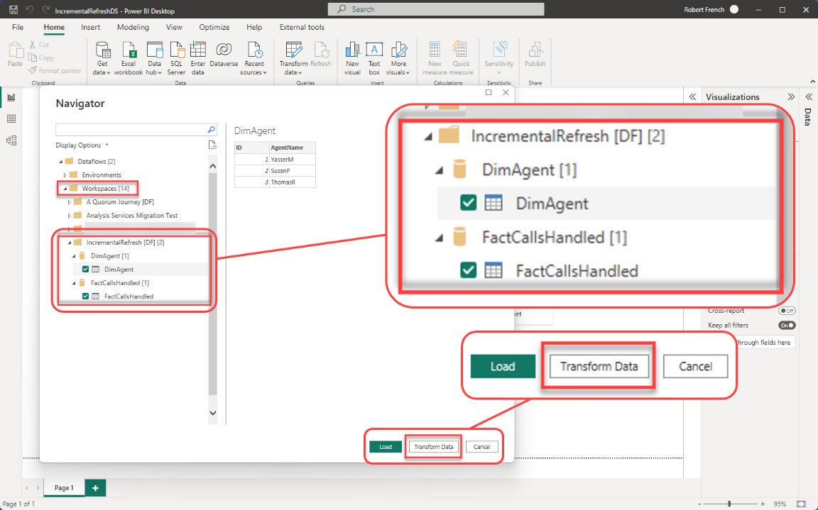

Slide 80
Add two parameters
RangeStart
RangeEnd
NB must use exactly these names and they are case sensitive (no I do not know why)

Slide 81
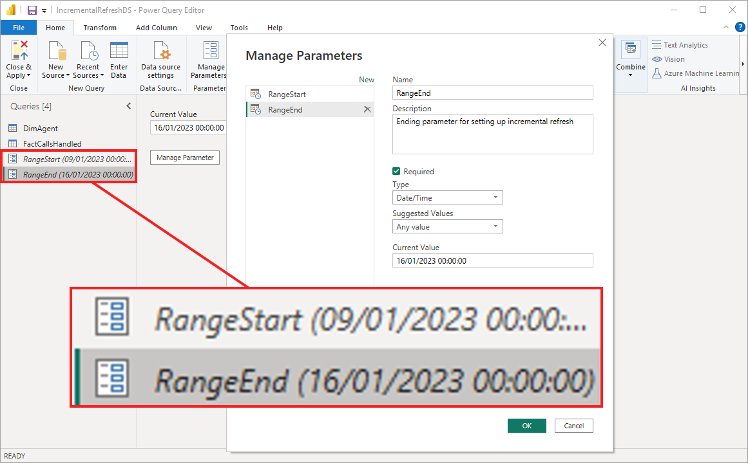

Slide 82
This Photo by Unknown Author is licensed under CC BY-SA
Notes:
Why should you use incremental refresh

Slide 83

Notes:
Photo by Annie Spratt on Unsplash

Slide 84
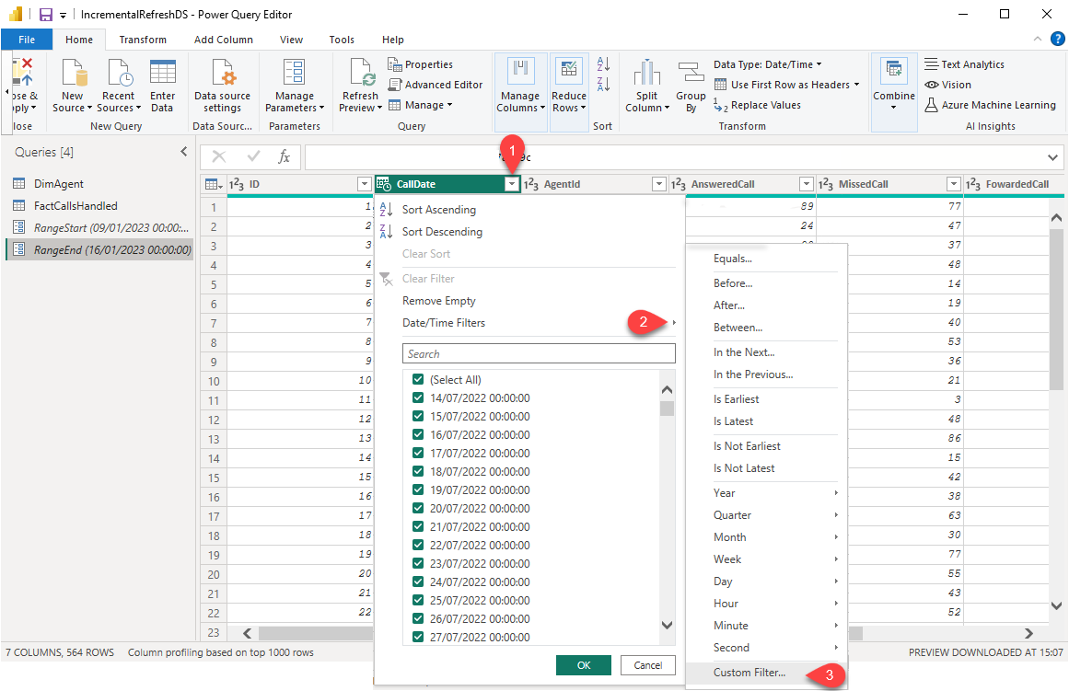

Slide 85
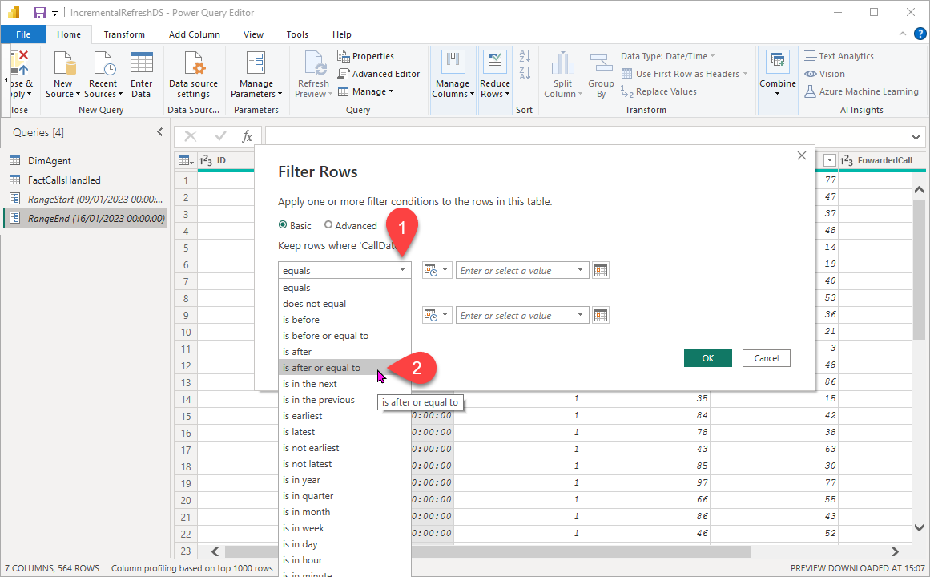

Slide 86
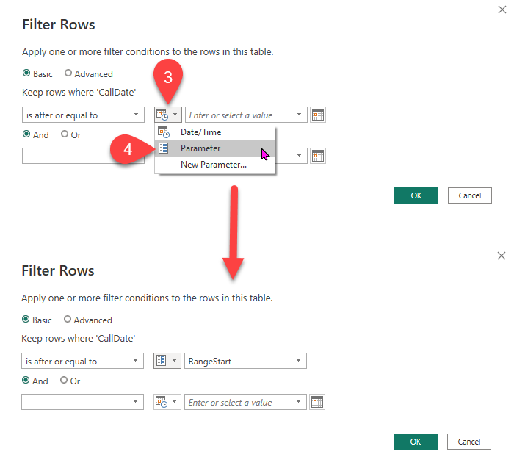

Slide 87
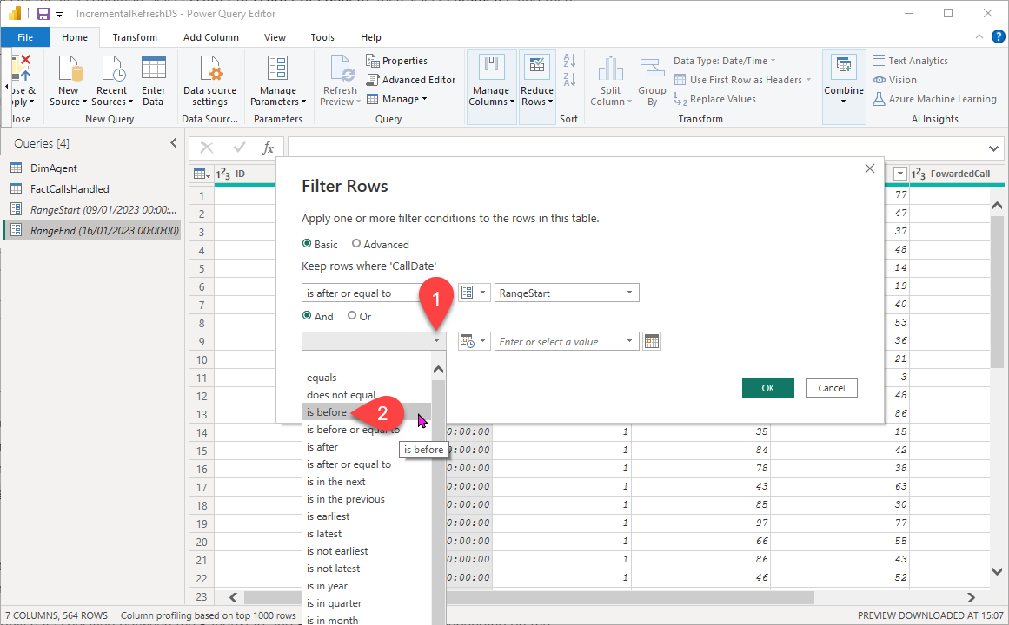

Slide 88
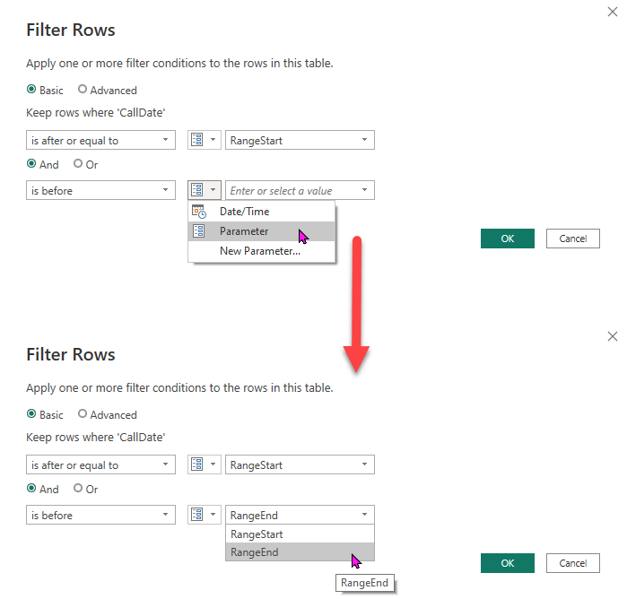

Slide 89
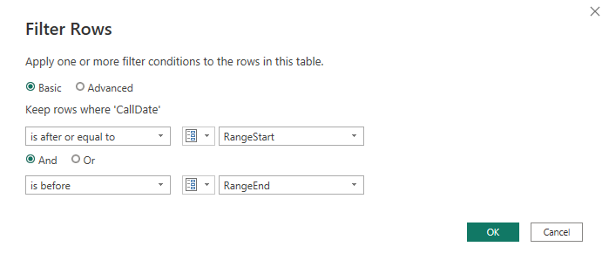

Slide 90
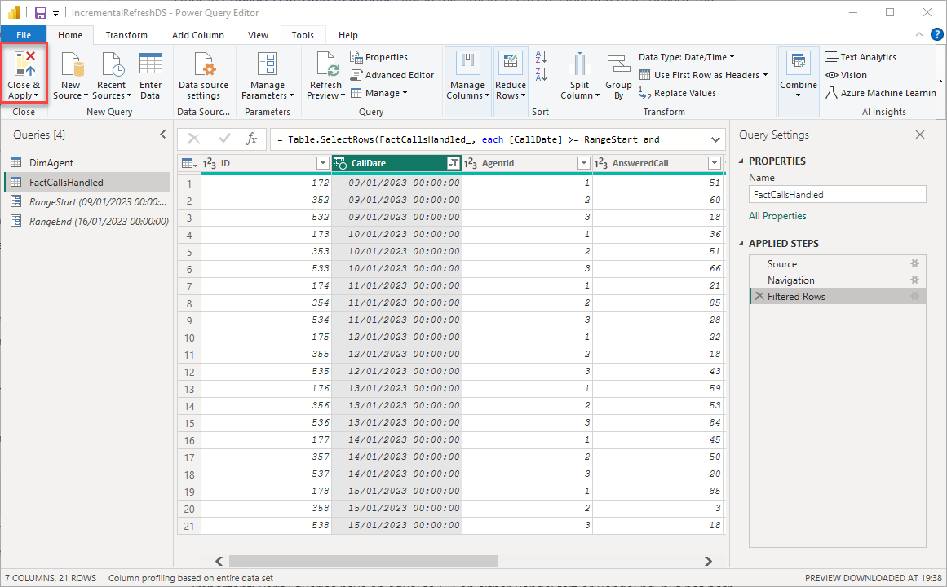

Slide 91


Slide 92
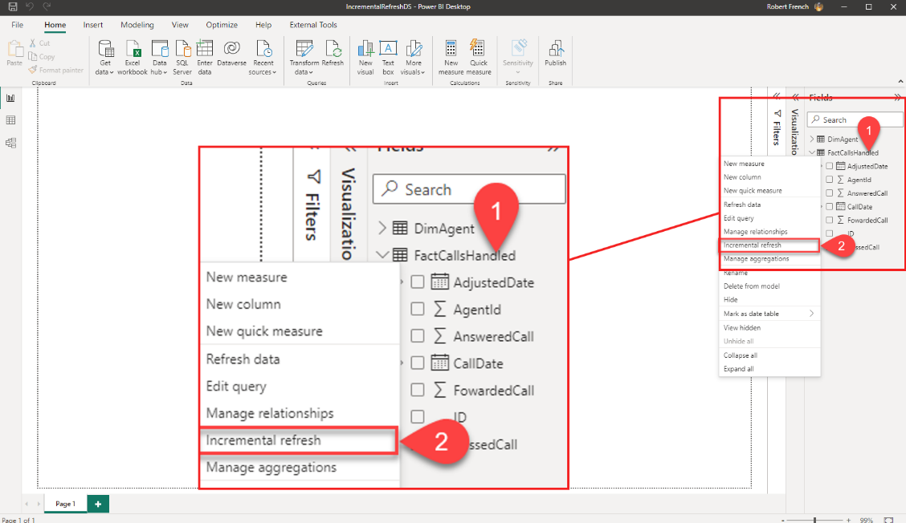

Slide 93
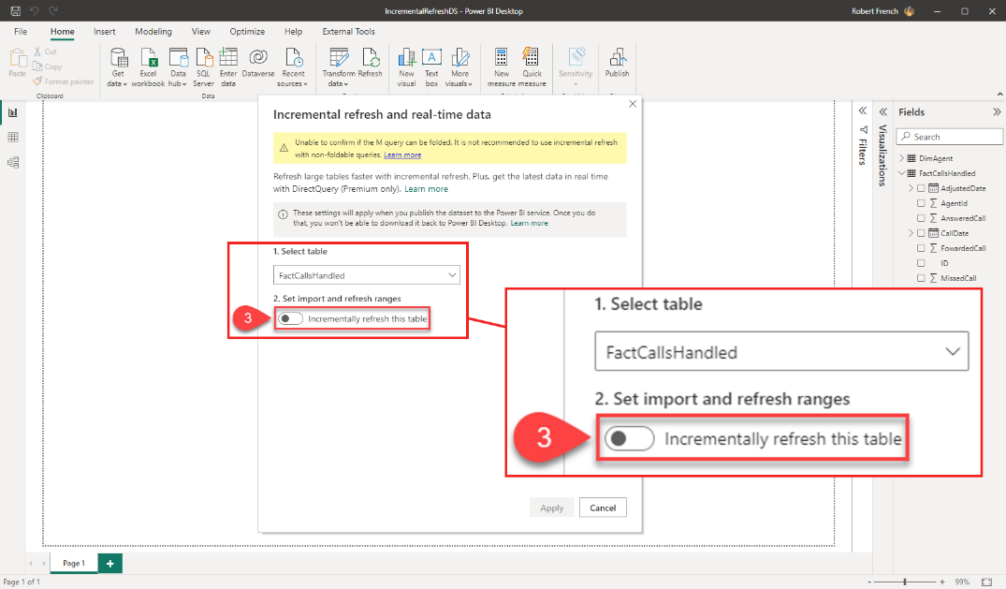

Slide 94
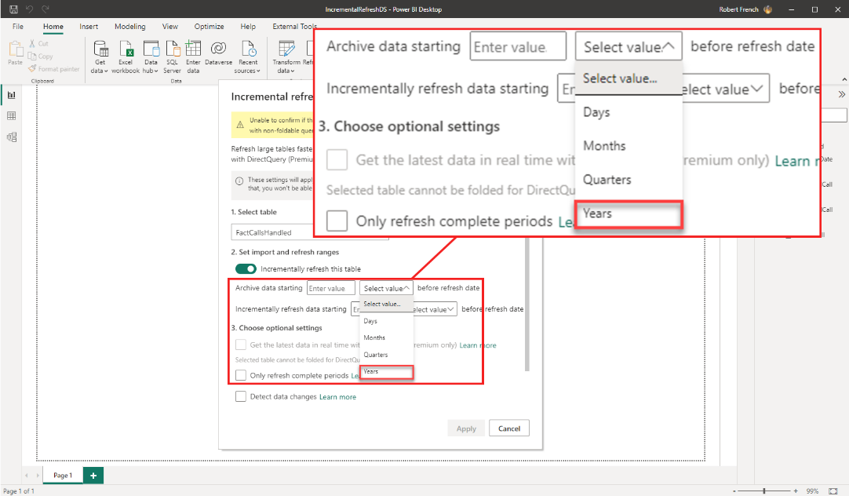

Slide 95
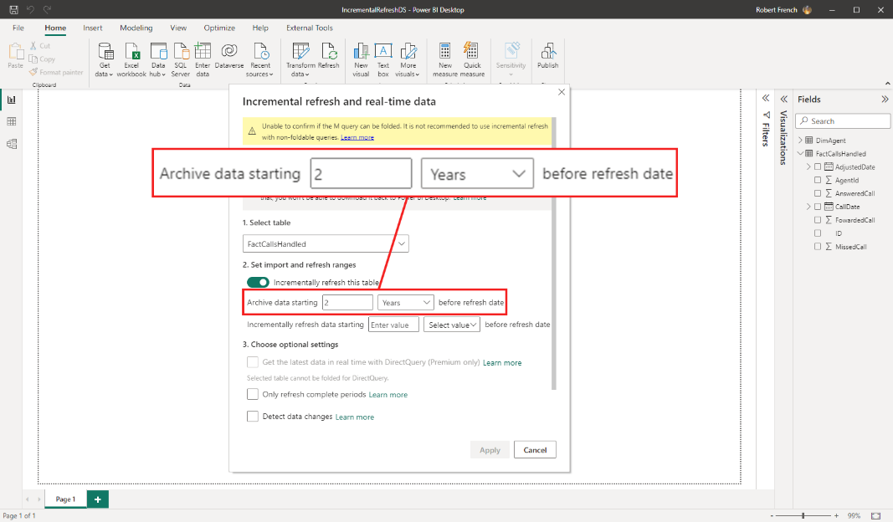

Slide 96
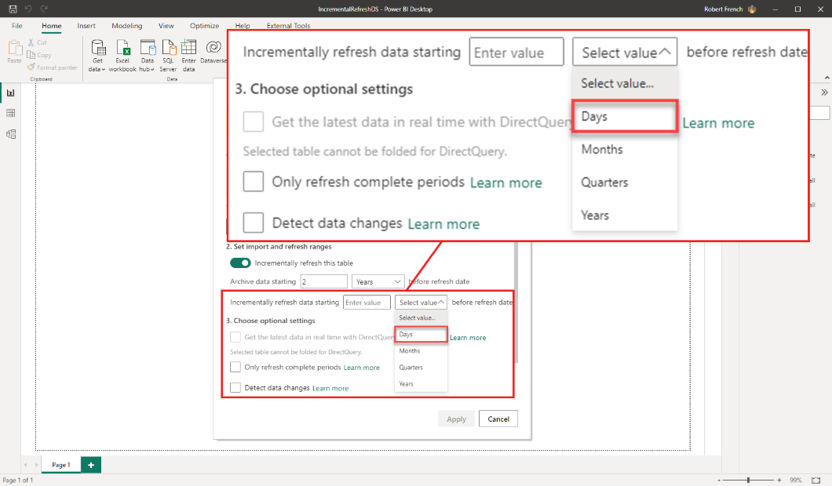

Slide 97
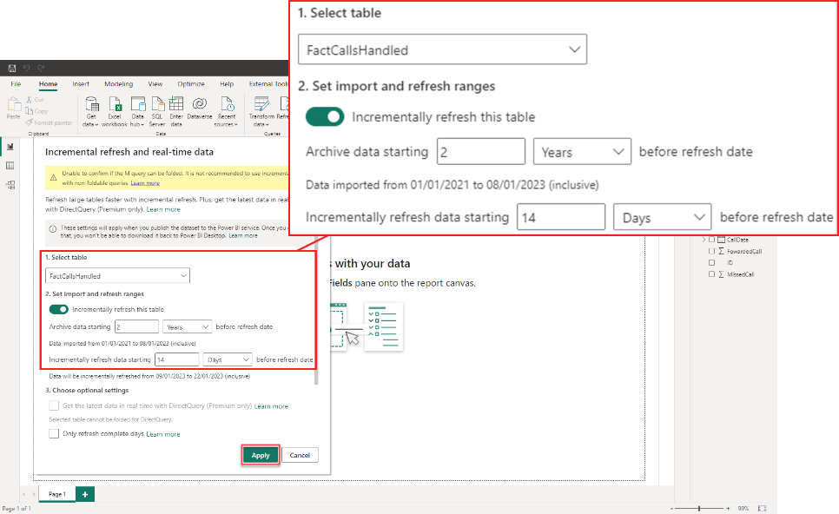

Slide 98
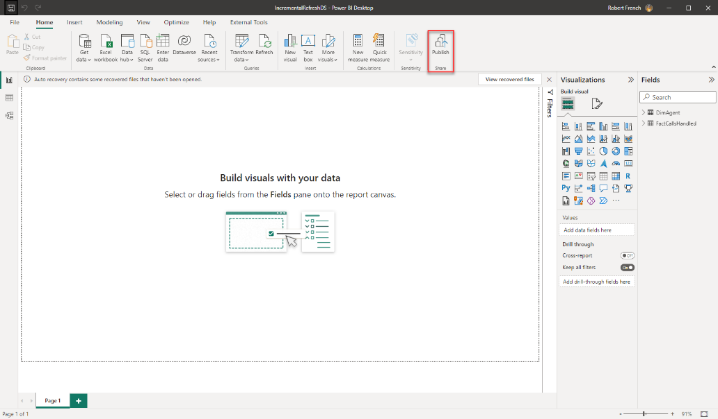

Slide 99
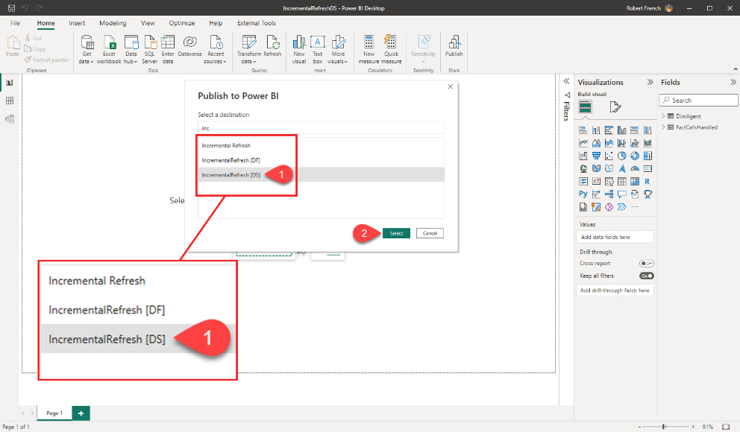

Slide 100
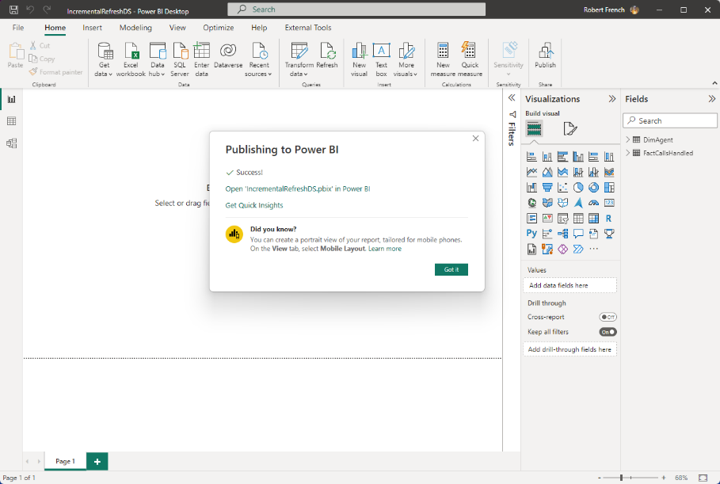

Slide 101
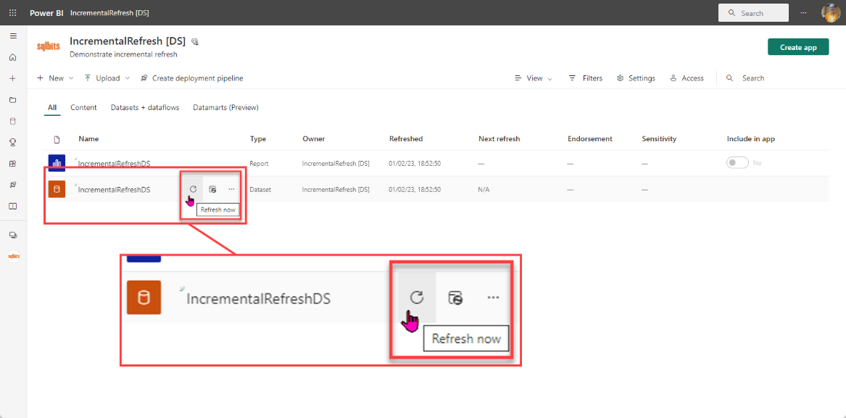
Notes:
You must refresh the dataset at least once to initialise the dataflow

Slide 102
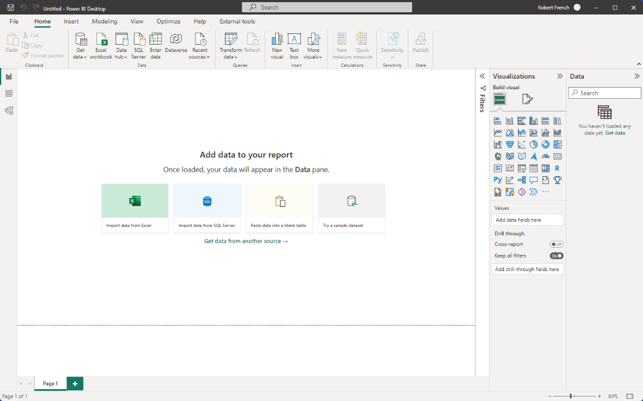

Slide 103
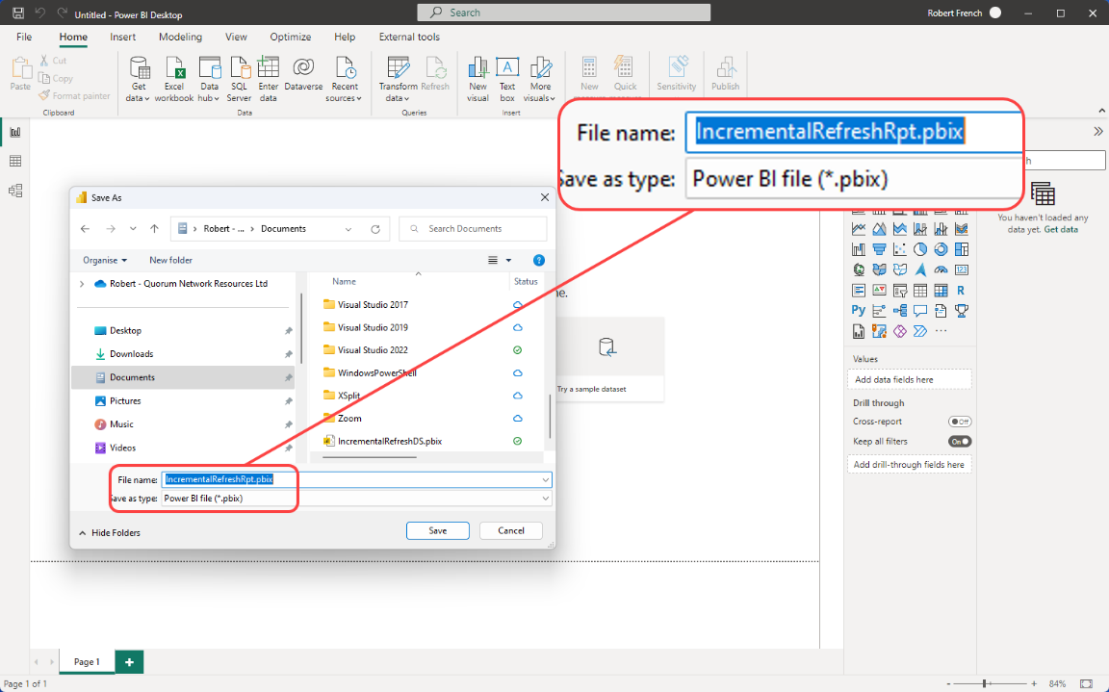

Slide 104
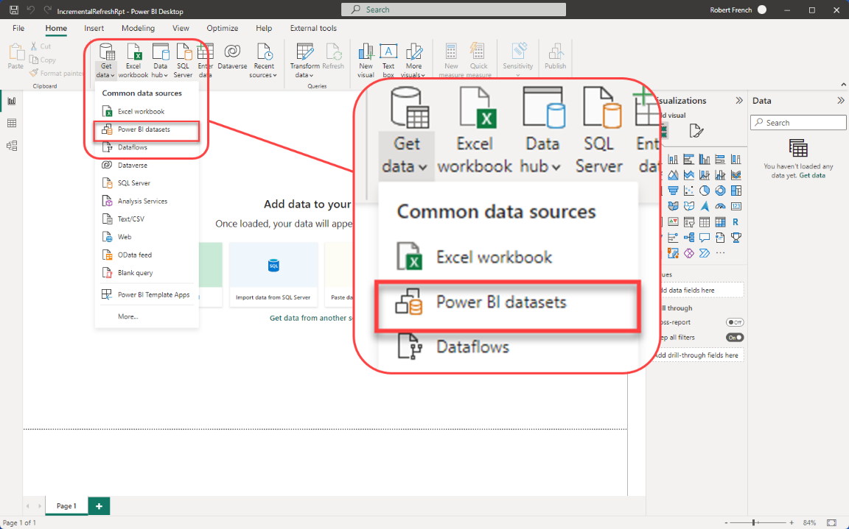

Slide 105
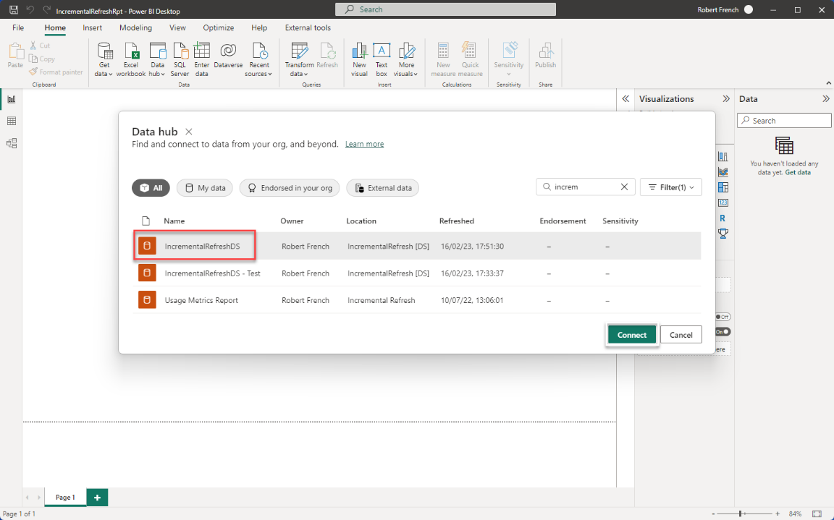

Slide 106
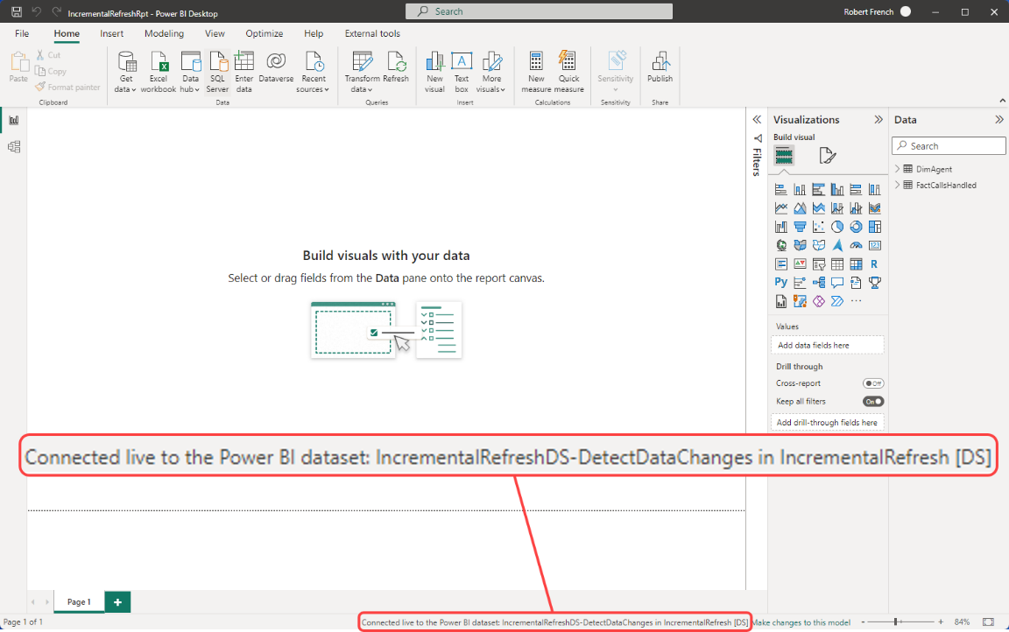

Slide 107
OR Open the report called
IncrementalRefreshRpt.pbix

Slide 108
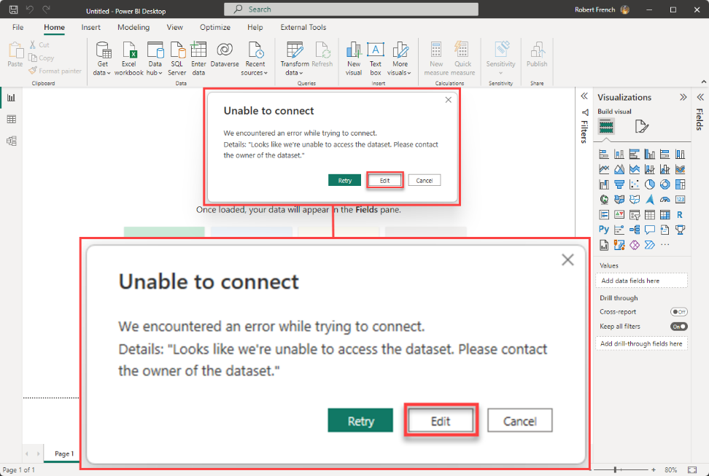

Slide 109
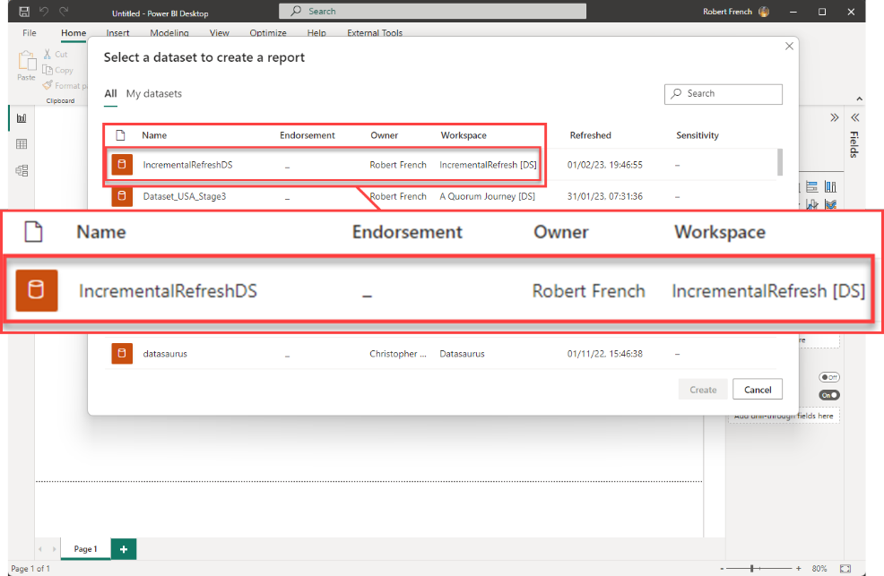

Slide 110
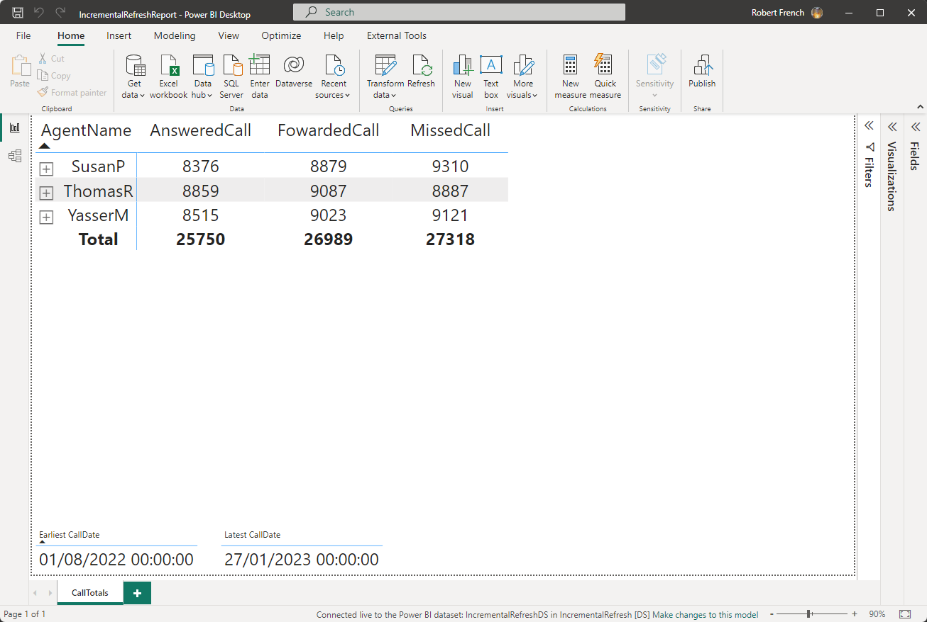

Slide 111

ConfirmTotals.sql

Slide 112


Slide 113
Phew now ready to start !

Slide 114
Step 4 - UpdateFactTableDayByDay.sql
Pseudo code
Find Last date in dataset (eg 1st Jan 2023)
Insert single record for each Agent
Set CallDate = Last date in dataset
Set CallsAnswered to 100
Set CallsFowarded to 100
Set CallMissed to 100

Slide 115

Step 4 - UpdateFactTableDayByDay.sql

Slide 116


Slide 117


Slide 118
The incremental Data Set
Archived Data
Incrementally refreshed data
The data was inserted into here.

Slide 119
Step 5 - UpdateFactTableLatestDateCallFigures.sql
Pseudo code
Find last date in dataset (eg 1st Jan 2023)
Update values for the records of each Agent
WHERE CallDate = Last date in dataset
Update CallsAnswered Add 5
Update CallsFowarded Add 5
Update CallMissed to Minus 5

Slide 121


Slide 122
The incremental Data Set
Archived Data
Incrementally refreshed data
The data was update in here.

Slide 123
Step 6 –
UpdateFactTableDeleteEarliestDateCallFigures.sql
Pseudo code
Find Last date in dataset (e.g. 1st Jan 2023)
Delete all records
WHERE CallDate = Last date in dataset

Slide 125


Slide 126
The incremental Data Set
Archived Data
Incrementally refreshed data
The data was deleted from here.

Slide 127
Step 7 –
DeleteLastRecordFactTableCallFigures.sql
Pseudo code
Delete all records
WHERE CallDate = First date in dataset
(e.g. 1st Jan 2021)

Slide 129


Slide 130
The incremental Data Set
Archived Data
Incrementally refreshed data
The data was deleted from here.

Slide 131
The incremental Data Set
Archived Data
Incrementally refreshed data
The data was (not) deleted from here.

Slide 132
The incremental Data Set
This data will be reloaded each time the refresh is run
Archived Data
Incrementally refreshed data
This data will not be refreshed when increment refresh runs.

Slide 133

Notes:
Photo by Joel M Mathey on Unsplash
What about slowing changing dimensions?

Slide 134

Notes:
Photo by Joel M Mathey on Unsplash
Lets look at the fact table again

Slide 135
Notes:
The call date is the field used as part of the incremental refresh

Slide 136


Slide 137
Step 8 –
UpdateFactTableSetAdjustedDateToCallDate.sql
Pseudo code
Set AdjustedDate = Call Date

Slide 138


Slide 139


Slide 140


Slide 141
Step 9 –
UpdateFactTableLatestDateCallFigures.sql
Pseudo code
Find First CallDate in dataset (e.g. 1st Jan 2021)
Update values of calls for records
WHERE CallDate = First CallDate
Update AdjustedDate = CurrentDateTime

Slide 144

Notes:
Photo by Sander Sammy on Unsplash
Confused?

Slide 145
The incremental Data Set
The CallDate of record is here.
Archived Data
Incrementally refreshed data
The AdjustedDate of record is here.

Slide 146

Notes:
Photo by Miguel Á. Padriñán: https://www.pexels.com/photo/close-up-shot-of-keyboard-buttons-2882553/

Slide 147

Notes:
Photo by Ann H: https://www.pexels.com/photo/a-text-on-a-pink-surface-11141929/

Slide 148
Step 10 –
AddIsDeletedColumn.sql
Pseudo code
Add column ‘IsDeleted’ to FactTable Set value of ‘IsDeleted’ to FALSE

Slide 149

In the Data Flow
Add filter to ‘IsDeleted’ column

Slide 150

Set filter to FALSE

Slide 151

In the Data Set
Add filter to ‘IsDeleted’ column

Slide 152

Set filter to FALSE

Slide 153
Step 11 –
SoftDeleteLastRecord.sql
Pseudo code
Find First CallDate in dataset (e.g. 1st Jan 2021)
Update values of calls for records
WHERE CallDate = First CallDate
Update AdjustedDate = CurrentDateTime
Update IsDeleted = 1

Slide 155


Slide 156
Soft
Notes:
Photo by Miguel Á. Padriñán: https://www.pexels.com/photo/close-up-shot-of-keyboard-buttons-2882553/

Slide 158

Notes:
Photo by RODNAE Productions: https://www.pexels.com/photo/photo-of-a-we-have-more-signage-7563581/

Slide 159

Notes:
Photo by Tim Mossholder on Unsplash

Slide 160

XMLA end point required

Slide 161


Slide 162


Slide 163


Slide 164


Slide 165


Slide 166


Slide 167


Slide 168

Notes:
https://commons.wikimedia.org/wiki/File:Clock_reversed.gif

Slide 169
bit.ly/3iqCb6P
Notes:
All the code files and links are in the repo.

Slide 170

Feedback
https://sqlb.it/?9917

Slide 172

Data Duckies

Slide 173
Robert French
Data Shepherd,
Data Plumber,
Data Dance Teacher
#DressUpFriday
https://www.qnrl.com/
@SqlBobScot @techhub.social
https://www.linkedin.com/in/rwlpfrench/
@SqlBobScot
rwlp.french@gmail.com

Slide 174

Notes:
Photo by Clark Tibbs on Unsplash

